Slide 1


Hyrje ne Javascript
01
JAVASCRIPT
Powered By

Slide 2

https://github.com/ https://github.com/ardiqestaj

Slide 3
Content
Arrays
Creating arrays
Accessing arrays
Array methods
Iterating Through Arrays
Advanced Array Methods
Multi-Dimensional Arrays
Introduction to Objects
Creating Objects
Accessing Object Properties
Modifying Object Properties
Iterating Through Objects
Object Methods

Slide 4
Arrays

Slide 5
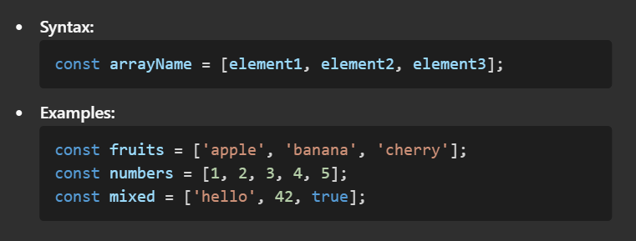
Creating Arrays

Slide 6
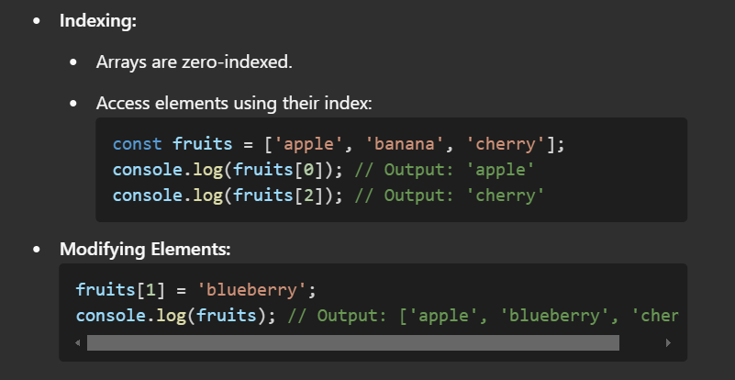
Accessing Array Elements

Slide 7
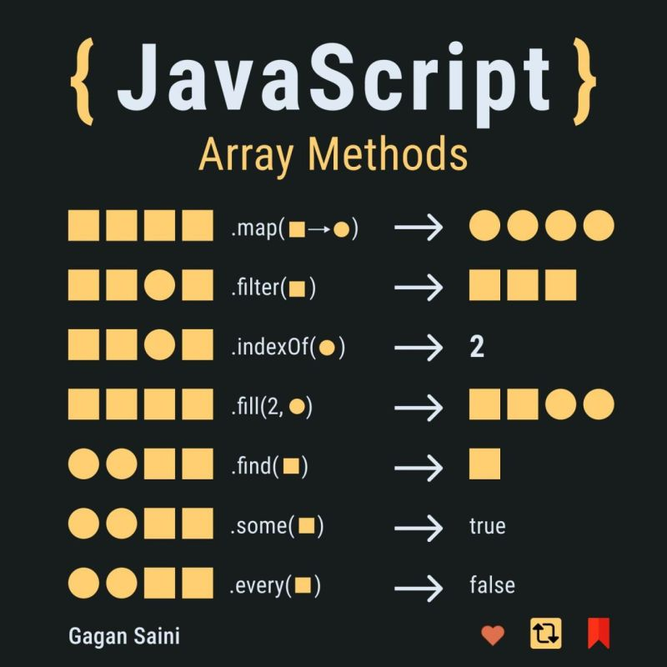
Array Methods

Slide 8
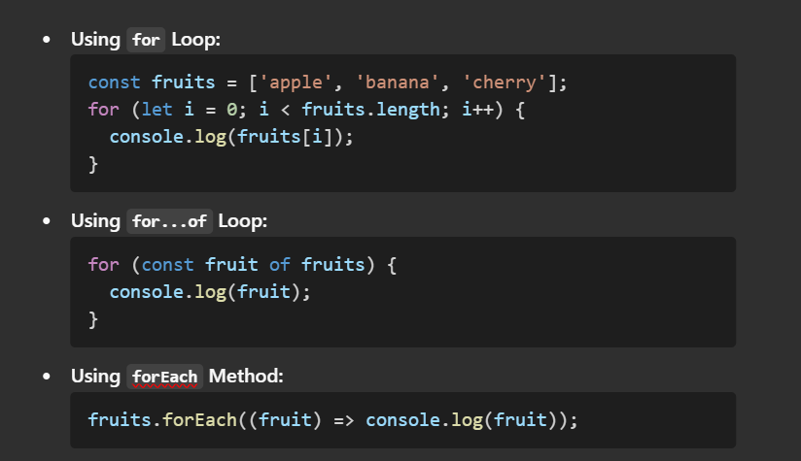
Iterating Through Arrays

Slide 9
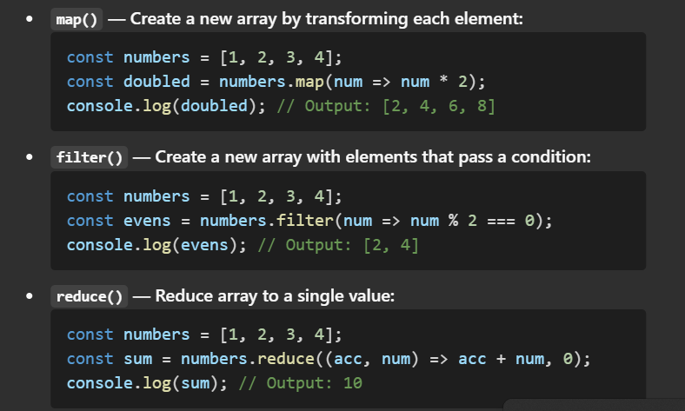
Advanced Array Methods

Slide 10
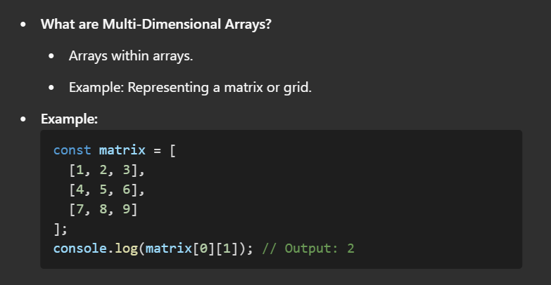
Multi-Dimensional Arrays

Slide 11
Introduction to Objects
What is an Object?
A collection of key-value pairs.
Represents real-world entities and their properties.
Why Use Objects?
To structure and organize data.
Example: Representing a user with properties like name, age, and email.

Slide 12
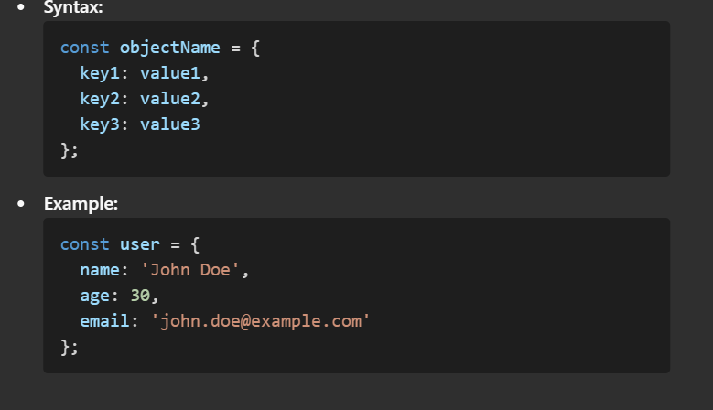
Creating Objects

Slide 13
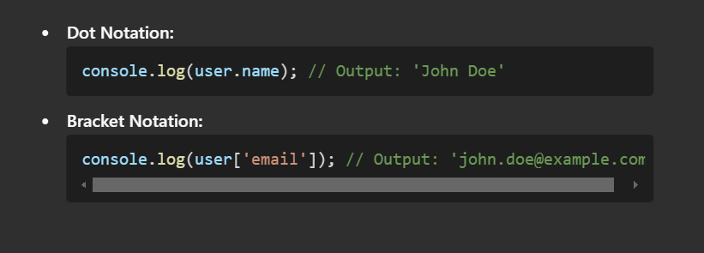
Accessing Object Properties

Slide 14
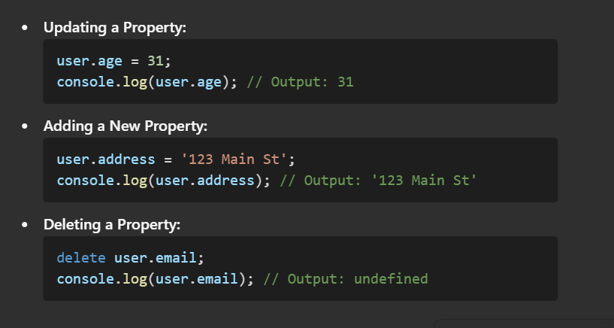
Modifying Object Properties

Slide 15
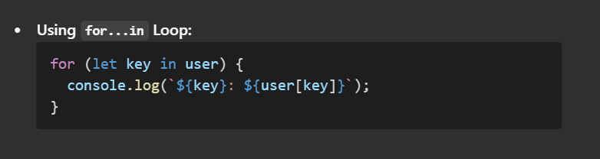
Iterating Through Object

Slide 16
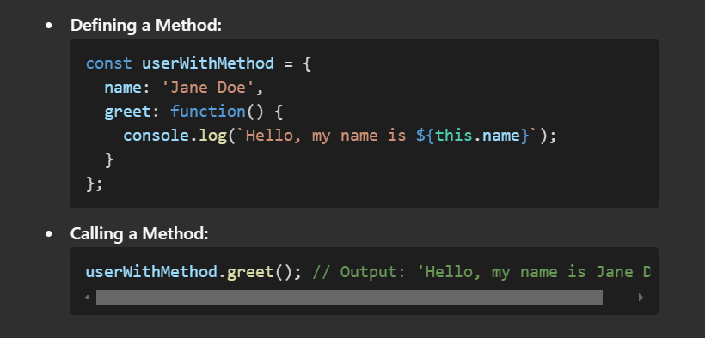
Object Methods

Slide 17
Projects
http://preview.themeforest.net/item/testo-restaurant-cafe-reactjs-nextjs-template/full_screen_preview/45358209?_ga=2.239457859.117493441.1737468129-1011996984.1654789992

Slide 18
15
FALEMINDERIT PER VEMENDJEN!

Slide 19
https://discord.gg/EYBmyQsR

